Slide 1
Software Engineering
116U01C501

Slide 2
MODULE 2: Requirement Engineering
2.1 Introduction to Object Oriented Methodologies :Booch, Rumbaugh and Jacobson
2.2 Requirements Engineering Tasks, Requirement Elicitation Techniques, Software Requirements: Functional, Non- Functional
2.3 Requirements Characteristics, Requirement qualities, Requirement Specification, Requirement Traceability, System Analysis Model Generation, Documentation :Use Case Diagram, Activity Diagram
2.4 Categorizing classes: entity, boundary and control, Modelling associations and collections-Class Diagram
2.5 Dynamic Analysis - Identifying Interaction – Sequence and Collaboration diagrams, State chart diagram

Slide 3
Introduction to Object Oriented Methodologies :Booch, Rumbaugh and Jacobson
•Engineering is a problem-solving activity. Engineers search for an appropriate solution, often by trial and error, evaluating alternatives empirically, with limited resources and incomplete knowledge
•Engineering method includes five steps:
1. Formulate the problem.
2. Analyse the problem.
3. Search for solutions.
4. Decide on the appropriate solution.
5. Specify the solution.

Slide 4
Introduction to Object Oriented Methodologies
•Object-oriented software development typically includes activities:
Requirements gathering
Analysis
System design
Object design
Implementation
Testing

Slide 5
Introduction to Object Oriented Methodologies
Booch Methodology –Object Oriented Analysis and Design (OOAD)- Grady Booch
Rumbaugh- Object Modeling Technique (OMT)- James Rambaugh
The Jacobson methodology – OOSE,OOBE- Ivar Hjalmar Jacobson

Slide 6
OO Software Engineering
•Requirement Elicitation & Analysis
•Formulate the problem with the client and build the application domain model.
•Requirements elicitation and analysis correspond to steps 1 and 2 of the engineering method (formulate & analyse the problem )
System design
•Analyse the problem, break it down into smaller pieces, and select general strategies for designing the System
Object design
•select detail solutions for each piece and decide on the most appropriate solution.
•System design and object design result in the solution domain model.
•System and object design correspond to steps 3 and 4 of the engineering method (search for solutions & decide upon appropriate solution)

Slide 7
OO Software Engineering
Implementation
Realize the system by translating the solution domain model into an executable representation
Implementation corresponds to step 5 of the engineering method (Specify solution)
What makes software engineering different from problem solving in other sciences is that change occurs in the application and the solution domain while the problem is being solved.

Slide 8
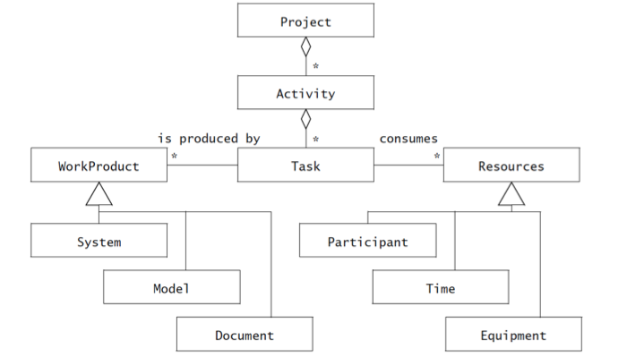
OO Software Engineering

Slide 9
OO Software Engineering
Each rectangle represents a concept.
The lines among the rectangles represent different relationships between the concepts.
For example, the diamond shape indicates aggregation: a Project includes a number of Activities, which includes a number of Tasks.
The triangle shape indicates a generalization relationship; Participants, Time, and Equipment are specific kinds of Resources
Persons involved (client, project manager, developers, end users) in the project as participants
A set of responsibilities in the project or the system as a role
A role is associated with a set of tasks and is assigned to a participant

Slide 10
OO Software Engineering
Terminology
System as a collection of interconnected parts
Model refers to any abstraction of the system (Modelling is a way to deal with complexity by ignoring irrelevant details).
A work product is an artefact that is produced during the development, such as a document or a piece of software for other developers or for the client.
Internal work product: A work product for the project’s internal consumption
A deliverable: a work product that must be delivered to a client
Deliverables are generally defined prior to the start of the project and specified by a contract binding the developers with the client

Slide 11
OO Software Engineering
An activity/ phases is a set of tasks that is performed toward a specific purpose
Requirements elicitation is an activity whose purpose is to define with the client what the system will do.
Delivery is an activity whose purpose is to install the system at an operational location.
Management is an activity whose purpose is to monitor and control the project such that it meets its goals (e.g., deadline, quality, budget). Activities can be composed of other activities.
A task represents an atomic unit of work that can be managed: A manager assigns it to a developer, the developer carries it out, and the manager monitors the progress and completion of the task.
Tasks consume resources, result in work products, and depend on work products produced by other tasks.
Resources are assets that are used to accomplish work.
Resources include time, equipment, and labour. When planning a project, a manager breaks down the work into tasks and assigns them to resources

Slide 12
TicketDistributor a case study
TicketDistributor is a machine that distributes tickets for trains.
Travelers have the option of selecting a ticket for a single trip or for multiple trips, or selecting a time card for a day or a week.
The TicketDistributor computes the price of the requested ticket based on the area in which the trip will take place and whether the traveller is a child or an adult.
The TicketDistributor must be able to handle several exceptions, such as travellers who do not complete the transaction, travellers who attempt to pay with large bills, and resource outages, such as running out of tickets, change, or power.

Slide 13
OO Software Engineering
Steps to be followed while designing the system requirements
Identify roles & responsibilities of various stakeholders
Identify the various work products
Identify various activities, tasks & resources
Identify Requirements

Slide 14
TicketDistributor a sample
Write the different people and their roles & responsibilities in the TicketDistributor system

Slide 15
TicketDistributor a case study
The different people and their roles & responsibilities in the TicketDistributor system
Role | Example | Responsibility
Client | Train company | The client is responsible for providing the high-level requirements on the system and for defining the scope of the project (delivery date, budget, quality criteria).
User | Travelers | The user is responsible for providing domain knowledge about current user tasks. Note that the client and the user are usually filled by different persons.
Human factors specialist | HCI specialist | A human factors specialist is responsible for the usability of the system.

Slide 16
TicketDistributor a case study
Role | Example | Responsibility
Manager | Project manager | A manager is responsible for the work organization. This includes hiring staff, assigning them tasks, monitoring their progress, providing for their training, and generally managing the resources provided by the client for a successful delivery.
Developer | Analyst, tester | A developer is responsible for the construction of the system, including specification, design, implementation, and testing. In large projects, the developer role is further specialized.
Technical writer |  | The technical writer is responsible for the documentation delivered to the client. A technical writer interviews developers, managers, and users to understand the system.

Slide 17
TicketDistributor a case study
Some sample work products
Work product | Type | Description
Specifications | Deliverable | The specification describes the system from the user’s point of view. It is used as a contractual document between the project and the client. The TicketDistributor specification describes in detail how the system should appear to the traveler
Operation Manual | Deliverable | The operation manual for the TicketDistributor is used by the staff of the train company responsible for installing and configuring the TicketDistributor. Such a manual describes, for example, how to change the price of tickets and the structure of the network into zones.

Slide 18
TicketDistributor a case study
Work product | Type | Description
Status Report | Internal work product | A status report describes at a given time the tasks that have been completed and the tasks that are still in progress. The status report is produced for the manager, Alice, and is usually not seen by the train company.
Test A | Internal work product | The test plans and results are produced by the tester, Zoe. These documents track the known defects in the prototype TicketDistributor and their state of repair. These documents are usually not shared with the client.

Slide 19
TicketDistributor a case study
Activities, tasks, and resources for the TicketDistributor project.
Work product | Type | Description
Requirements elicitation | Activity | The requirements elicitation activity includes obtaining and validating requirements and domain knowledge from the client and the users. The requirements elicitation activity produces the specification work product
Develop “Out of Change” test case for TicketDistributor | Task | This task, assigned to the tester focuses on verifying the behaviour of the ticket distributor when it runs out of money and cannot give the correct change back to the user. This activity includes specifying the environment of the test, the sequence of inputs to be entered, and the expected outputs.

Slide 20
TicketDistributor a case study
Activities, tasks, and resources for the TicketDistributor project.:
Work product | Type | Description
Review “Access Online Help” use case for usability | Task | This task, assigned to the human factors specialist focuses on detecting usability issues in accessing the online help features of the system. The tariff database includes an example of tariff structure with a train network plan. This example is a resource provided by the client for requirements and testing.
Tariff Database | Resource | The tariff database includes an example of tariff structure with a train network plan. This example is a resource provided by the client for requirements and testing.

Slide 21
OOSE
Steps while designing the system requirements
Identify roles & responsibilities of various stakeholders
Identify the various work products
Identify various activities, tasks & resources
Identify Requirements

Slide 22
OOSE
Steps while designing the system requirements
Identify requirements:
•Requirements specify a set of features that the system must have.
•A functional requirement is a specification of a function that the system must support
•A nonfunctional requirement is a constraint on the operation of the system that is not related directly to a function of the system.
•E.g. classify into functional requirements
1.The user must be able to purchase tickets
2.The user must be able to access tariff information
non functional requirements
3.The user must be provided feedback in less than one second
4.The colours used in the interface should be consistent with the company

Slide 23
OOSE
Notations, Methods & Methodology
•A notation is a graphical or textual set of rules for representing a model.
•A method is a repeatable technique that specifies the steps involved in solving a specific problem.
•A methodology is a collection of methods for solving a class of problems and specifies how and when each method should be used.
Different object-oriented methodologies
•Royce’s methodology
•The Object Modelling Technique (OMT) Rumbaugh et al.
•The Booch methodology
•Catalysis

Slide 24
OOSE activities
Technical activities associated with object-oriented software engineering.
•Development activities deal with the complexity by constructing and validating models of the application domain or the system
•Development activities:
• Requirements Elicitation
• Analysis
• System Design
• Object Design
• Implementation
• Testing

Slide 25
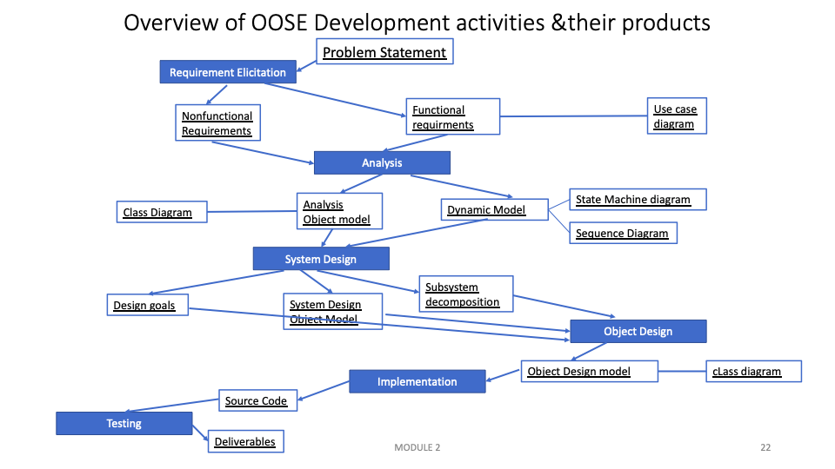
OMT (Rambaugh)
OMT provides methods for three activities:
•Analysis, which focuses on formalizing the system requirements into an object model
•System Design, which focuses on strategic decisions, and
•Object Design, which transforms the analysis model into an object model that can be implemented.
•The OMT methodology assumes that requirements have already been defined and does not provide methods for eliciting requirements.
The Unified Software Development Process includes TWO activities:
•Analysis activity
•Design activity which includes System Design and Object Design
•Includes a Requirements Capture activity for eliciting and modelling requirements.
Catalysis:
•while using the same notations as the Unified Process, focuses more on reuse of design and code using patterns and frameworks.
All of these methodologies focus on dealing with complex systems

Slide 26
OOSE activities
•Development activities:
• Requirements Elicitation
•The client and developers define the purpose of the system.
•The result of this activity is a description of the system in terms of actors and use cases.
•Actors represent the external entities that interact with the system.
Actors include roles such as end users, other computers the system needs to deal with (e.g., a central bank computer, a network), and the environment (e.g., a chemical process).
•Use cases are general sequences of events that describe all the possible actions between an actor and the system for a given piece of functionality.

Slide 27
OOSE activities
•Development activities:
• Requirement Elicitation
•Analysis
•Developers aim to produce a model of the system that is correct, complete, consistent, and unambiguous
•Developers transform the use cases produced during requirements elicitation into an object model that completely describes the system
•Developers discover ambiguities and inconsistencies in the use case model that they resolve with the client
•The result of analysis is a system model annotated with attributes, operations, and associations.
•The system model can be described in terms of its structure and its dynamic interoperation.

Slide 28
OOSE activities
•Development activities:
• Requirement Elicitation
• Analysis
• System Design
•Developers define the design goals of the project and decompose the system into smaller subsystems that can be realized by individual teams.
•Developers also select strategies for building the system, such as the hardware/software platform on which the system will run, the persistent data management strategy, the global control flow, the access control policy, and the handling of boundary conditions.
•The result of system design is a clear description of each of these strategies, a subsystem decomposition, and a deployment diagram representing the hardware/software mapping of the system.
•Whereas both analysis and system design produce models of the system under construction, only analysis deals with entities that the client can understand.
•System design deals with a much more refined model that includes many entities that are beyond the comprehension (and interest) of the client.

Slide 29
OOSE activities
•Development activities:
•Requirement Elicitation
• Analysis
• System Design
• Object Design
•Developers define solution domain objects to bridge the gap between the analysis model and the hardware/software platform defined during system design.
•Precisely describing object and subsystem interfaces, selecting off-the-shelf components, restructuring the object model to attain design goals such as extensibility or understandability, and optimizing the object model for performance.
•A detailed object model annotated with constraints and precise descriptions for each element.

Slide 30
OOSE activities
•Development activities:
• Requirement Elicitation
• Analysis
• System Design
•Object Design
• Implementation
•Developers translate the solution domain model into source code.
•Includes implementing the attributes and methods of each object and integrating all the objects such that they function as a single system.
•The implementation activity spans the gap between the detailed object design model and a complete set of source code files that can be compiled.

Slide 31
OOSE activities
•Development activities:
•Requirement Elicitation • Analysis • System Design • Object Design •Implementation
• Testing
•Developers find differences between the system and its models by executing the system (or parts of it) with sample input data sets.
•Developers compare the object design model with each object and subsystem.
•During integration testing, combinations of subsystems are integrated together and compared with the system design model.
•During system testing, typical and exception cases are run through the system and compared with the requirements model.
•The goal of testing is to discover as many faults as possible such that they can be repaired before the delivery of the system.
•The planning of test phases occurs in parallel to the other development activities: System tests are planned during requirements elicitation and analysis, integration tests are planned during system design, and unit tests are planned during object design.

Slide 32
Question
Compare Booch, Rumbaugh and Jacobson approaches

Slide 33
Module 2: Requirement Engineering
•2.1 Introduction to Object Oriented Methodologies :Booch, Rumbaugh and Jacobson
2.2 Requirements Engineering Tasks, Requirement Elicitation Techniques, Software Requirements: Functional, Non- Functional
2.3 Requirements Characteristics, Requirement qualities, Requirement Specification, Requirement Traceability, System Analysis Model Generation, Documentation :Use Case Diagram, Activity Diagram
2.4 Categorizing classes: entity, boundary and control, Modelling associations and collections-Class Diagram
2.5 Dynamic Analysis - Identifying Interaction – Sequence and Collaboration diagrams, State chart diagram

Slide 34
Requirement Engineering Tasks
•Requirements Engineering includes two main activities:
1.Requirements elicitation, which results in the specification of the system that the client understands
2.Analysis, which results in an analysis model that the developers can unambiguously interpret.

Slide 35
Requirement Engineering Tasks
•Requirements Engineering includes two main activities:
1.Requirements elicitation,
Challenging of the because it requires the collaboration of several groups of participants with different backgrounds
•The client and the users are experts in their domain and have a general idea of what the system should do, but they often have little experience in software development
•The developers have experience in building systems, but often have little knowledge of the everyday environment of the users
•Scenarios and use cases provide tools for bridging this gap.
•A scenario describes an example of system use in terms of a series of interactions between the user and the system
•A use case is an abstraction that describes a class of scenarios.
•Both scenarios and use cases are written in natural language, a form that is understandable to the user.

Slide 36
Requirement Elicitation
Requirements elicitation: communication among developers, clients, and users to define a new system.
•Failure to communicate and understand each others’ domains results in a system that is difficult to use or that simply fails to support the user’s work.
•Errors introduced during requirements elicitation are expensive to correct
•Errors include missing functionality that the system should have supported, functionality that was incorrectly specified, user interfaces that are misleading or unusable, and obsolete functionality
•Requirements elicitation methods aim at improving communication among developers, clients, and users
•Developers construct a model of the application domain by observing users in their environment.
•Developers select a representation that is understandable by the clients and users
•Developers validate the application domain model by constructing simple prototypes of the user interface and collecting feedback from potential users.
•A use case is an abstraction that describes a class of scenarios.
•Both scenarios and use cases are written in natural language, a form that is understandable to the user.

Slide 37
Requirement Elicitation
•Requirements elicitation focuses on describing the purpose of the system.
•The client, the developers, and the users identify a problem area and define a system that addresses the problem.
•Thus a requirements specification is created and used as a contract between the client and the developers.
•The requirements specification supports the communication with the client and users
•The analysis model supports the communication among developers
• Requirements elicitation and analysis occur concurrently and iteratively

Slide 38
Requirement Elicitation
•Requirement elicitation Activities :
• Identifying actors : developers identify the different types of users the future system will support.
•Identifying scenarios: developers observe users and develop a set of detailed scenarios for typical functionality provided by the future system.
•Scenarios : concrete examples of the future system in use, used by the developers to communicate with the user and deepen their understanding of the application domain.
•Identifying use cases derived from the scenarios: a set of use cases that completely represent the future system which is abstractions describing all possible cases.
•Use cases are used to determine the scope of the system.
•Refining use cases : developers ensure that the requirements specification is complete by detailing each use case and describing the behaviour of the system in the presence of errors and exceptional conditions.
•Identifying relationships among use cases.
•Identify dependencies among use cases.
•Consolidate the use case model by factoring out common functionality ensuring the requirements specification is consistent.
•Identifying nonfunctional requirements. aspects that are visible to the user, but not directly related to functionality which includes constraints on the performance of the system, its documentation, the resources it consumes, its security, and its quality.

Slide 39
Requirement Elicitation
Sources for Requirements Developers access many different sources of information such as :
•Client-supplied documents about the application domain, manuals and technical documentation of legacy systems that the future system will replace
•users and clients themselves. Developers interact the most with users and clients during requirements elicitation.
Two methods for eliciting information, making decisions with users and clients, and managing dependencies among requirements and other artefacts:
•Joint Application Design (JAD) focuses on building consensus among developers, users, and clients by jointly developing the requirements specification.
•Traceability focuses on recording, structuring, linking, grouping, and maintaining dependencies among requirements and between requirements and other work products.

Slide 40
Requirement Elicitation
Functional Requirements:
•Describe the interactions between the system and its environment independent of its implementation.
•The environment includes the user and any other external system with which the system interacts.

Slide 41
Requirement Elicitation
Non- Functional Requirements:
•Describe aspects of the system that are not directly related to the functional behaviour of the system.
•Include a broad variety of requirements that apply to many different aspects of the system, such as
•Usability is the ease with which a user can learn to operate, prepare inputs for, and interpret outputs of a system or component.
•Usability requirements include, conventions adopted by the user interface, the scope of online help, and the level of user documentation.
•Clients address usability issues by requiring the developer to follow user interface guidelines on colour schemes, logos, and fonts.
•Reliability is the ability of a system or component to perform its required functions under stated conditions for a specified period of time.
•Include, an acceptable mean time to failure and the ability to detect specified faults or to withstand specified security attacks.

Slide 42
Requirement Elicitation
Non- Functional Requirements:
•Reliability is the ability of a system or component to perform its required functions under stated conditions for a specified period of time.
•Include, an acceptable mean time to failure and the ability to detect specified faults or to withstand specified security attacks.
•Dependability, which is the property of a computer system such that reliance can justifiably be placed on the service it delivers.
•Includes reliability, robustness (the degree to which a system or component can function correctly in the presence of invalid inputs or stressful environment conditions), and safety (a measure of the absence of catastrophic consequences to the environment).

Slide 43
Requirement Elicitation
Non- Functional Requirements:
•Performance requirements are concerned with quantifiable attributes of the system, such as response time (how quickly the system reacts to a user input), throughput (how much work the system can accomplish within a specified amount of time), availability (the degree to which a system or component is operational and accessible when required for use), and accuracy.
•Supportability requirements are concerned with the ease of changes to the system after deployment
•Includes adaptability (the ability to change the system to deal with additional application domain concepts), maintainability (the ability to change the system to deal with new technology or to fix defects), and internationalization (the ability to change the system to deal with additional international conventions, such as languages, units, and number formats).
•Implementation requirements are constraints on the implementation of the system, including the use of specific tools, programming languages, or hardware platforms.

Slide 44
Requirement Elicitation
Non- Functional Requirements:
•Interface requirements are constraints imposed by external systems, including legacy systems and interchange formats.
•Operations requirements are constraints on the administration and management of the system in the operational setting.
•Packaging requirements are constraints on the actual delivery of the system (e.g., constraints on the installation media for setting up the software).
•Legal requirements are concerned with licensing, regulation, and certification issues. systems must be accessible to people with disabilities etc.

Slide 45
Module 2: Requirement Engineering
•2.1 Introduction to Object Oriented Methodologies :Booch, Rumbaugh and Jacobson
2.2 Requirements Engineering Tasks, Requirement Elicitation Techniques, Software Requirements: Functional, Non- Functional
2.3 Requirements Characteristics, Requirement qualities, Requirement Specification, Requirement Traceability, System Analysis Model Generation, Documentation :Use Case Diagram, Activity Diagram
2.4 Categorizing classes: entity, boundary and control, Modelling associations and collections-Class Diagram
2.5 Dynamic Analysis - Identifying Interaction – Sequence and Collaboration diagrams, State chart diagram

Slide 46
Requirement Characteristics
Requirement Characteristics:
•Complete:
•All possible scenarios through the system are described
•All exceptional behaviour are mentioned (i.e., all aspects of the system are represented in the requirements model)
•Consistent:
•Not contradicting itself
•Unambiguous:
•one system is defined (i.e., it is not possible to interpret the specification two or more different ways)
•Correct:
•Represents accurately the system that the client needs and that the developers intend to build (i.e., everything in the requirements model accurately represents an aspect of the system to the satisfaction of both client and developer)

Slide 47
Requirement Characteristics
Requirement Characteristics:
•Realistic:
• Check if The system can be implemented within constraints
•Verifiable:
• Once the system is built, repeatable tests can be designed to demonstrate that the system fulfils the requirements specification
•Traceable:
•Each requirement can be traced throughout the software development to its corresponding system functions
•Each system function can be traced back to its corresponding set of requirements
•Enables a tester to assess the coverage of a test case, that is, to identify which requirements are tested and which are not.
•Enables the analyst and the developers to identify all components and system functions that the change would impact

Slide 48
Requirement Characteristics
Write down requirements of TicketDispenser
•Complete:
•Consistent:
•Unambiguous:
•Correct:

Slide 49
Requirements Elicitation Activities
•Identifying Actors:
•Actors represent external entities that interact with the system. An actor can be human or an external system
•Identifying Scenarios:
•Developers observe users and develop a set of detailed scenarios for typical functionality provided by the future system.
•Scenarios are concrete examples of the future system in use.
•Developers use these scenarios to communicate with the user and deepen their understanding of the application domain.
•Identifying Use Cases:
•Developers derive from the scenarios a set of use cases that completely represent the future system.
•Use cases are abstractions describing all possible cases.
•When describing use cases, developers determine the scope of the system.

Slide 50
Requirements Elicitation Activities
•Refining Use Cases:
•developers ensure that the requirements specification is complete by detailing each use case and describing the behaviour of the system in the presence of errors and exceptional conditions.
•Identifying Relationships Among Actors and Use Cases:
•developers identify dependencies among use cases.
•Consolidate the use case model by factoring out common functionality to ensures that the requirements specification is consistent.
•Identifying Nonfunctional Requirements:
•Developers, users, and clients agree on aspects that are visible to the user, but not directly related to functionality.
•These include constraints on the performance of the system, its documentation, the resources it consumes, its security, and its quality.

Slide 51
Requirements Analysis Document
1. Introduction
1.1 Purpose of the system
1.2 Scope of the system
1.3 Objectives and success criteria of the project
1.4 Definitions, acronyms, and abbreviations
1.5 References
1.6 Overview
2. Current system

Slide 52
Requirements Analysis Document
3. Proposed system
3.1 Overview
3.2 Functional requirements
3.3 Nonfunctional requirements
3.3.1 Usability
3.3.2 Reliability
3.3.3 Performance
3.3.4 Supportability
3.3.5 Implementation
3.3.6 Interface
3.3.7 Packaging
3.3.8 Legal
3.4 System models
3.4.1 Scenarios
3.4.2 Use case model
3.4.3 Object model
3.4.4 Dynamic model
3.4.5 User interface—navigational paths and screen mock-ups
4. Glossary

Slide 53
Requirements Elicitation Activities
Actors
•Questions for identifying actors:
• Which user groups are supported by the system to perform their work?
• Which user groups execute the system’s main functions?
• Which user groups perform secondary functions, such as maintenance and administration?
• With what external hardware or software system will the system interact?

Slide 54
Requirements Elicitation Activities
Scenarios
•As-is scenarios describe a current situation. The current system is understood by observing users and describing their actions as scenarios.
•These scenarios can then be validated for correctness and accuracy with the users.
•Visionary scenarios describe a future system.
•Visionary scenarios are used both as a point in the modelling space by developers as they refine their ideas of the future system and as a communication medium to elicit requirements from users.
•Visionary scenarios can be viewed as an inexpensive prototype.
•Evaluation scenarios describe user tasks against which the system is to be evaluated.
•The collaborative development of evaluation scenarios by users and developers also improves the definition of the functionality tested by these scenarios.
•Training scenarios are tutorials used for introducing new users to the system.
•These are step-by-step instructions designed to hand-hold the user through common tasks.

Slide 55
Requirements Elicitation Activities
Questions to identify Scenarios
What are the tasks that the actor wants the system to perform?
What information does the actor access? Who creates that data? Can it be modified or removed? By whom?
Which external changes does the actor need to inform the system about? How often? When?
Which events does the system need to inform the actor about? With what latency?

Slide 56
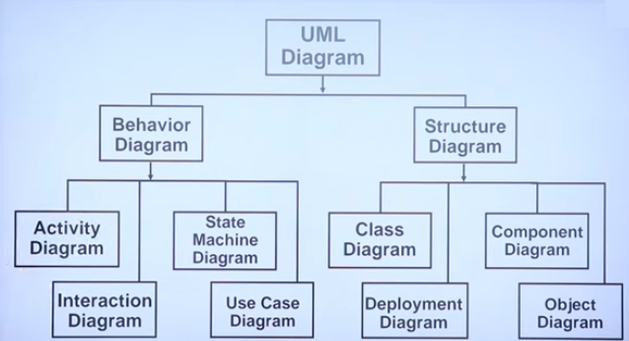

Slide 57
Requirements Elicitation Activities
Use Cases
A scenario is an instance of a use case; that is, a use case specifies all possible scenarios for a given piece of functionality.
A use case is initiated by an actor.
After its initiation, a use case may interact with other actors, as well.
A use case represents a complete flow of events through the system in the sense that it describes a series of related interactions that result from its initiation.

Slide 58
Requirements Elicitation Activities
Guidelines for Use Cases
Use cases should be named with verb phrases. The name of the use case should indicate what the user is trying to accomplish
Actors should be named with noun phrases
The boundary of the system should be clear. Steps accomplished by the actor and steps accomplished by the system should be distinguished (system actions are indented to the right).
Use case steps in the flow of events should be phrased in the active voice to explicitly represent who accomplished the step.
The causal relationship between successive steps should be clear.
A use case should describe a complete user transaction
Exceptions should be described separately.
A use case should not describe the user interface of the system.
A use case should not exceed two or three pages in length. Otherwise, use include and extend relationships to decompose it in smaller use cases

Slide 59
Requirements Elicitation Activities
Use Cases
Identifying Use Cases
Use cases represent what the actors want your system to do for them.
use case represents a complete flow of events through the system.
A Use Case captures some actor-visible function
- Achieves some discrete (business-level) goal for that actor
- May be read, write, or read-modify-write in nature

Slide 60
Requirements Elicitation Activities
Use Cases
Names begin with a verb – An use case models an action so the name should begin with a verb.
Make the name descriptive – This is to give more information for others who are looking at the diagram. For example “Print Invoice” is better than “Print”.
Highlight the logical order – For example if you’re analyzing a bank customer typical use cases include open account, deposit and withdraw. Showing them in the logical order makes more sense.
Place included use cases to the right of the invoking use case – This is done to improve readability and add clarity.
•Place inheriting use case below parent use case – Again this is done to improve the readability of the diagram.

Slide 61

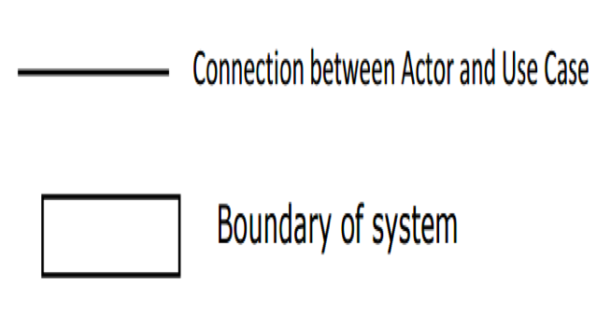

Requirements Elicitation Activities
Elements of Use Case
Actor
Stereotype relationship
(implicit or explicit)
System function (process – automated or manual).

Slide 62
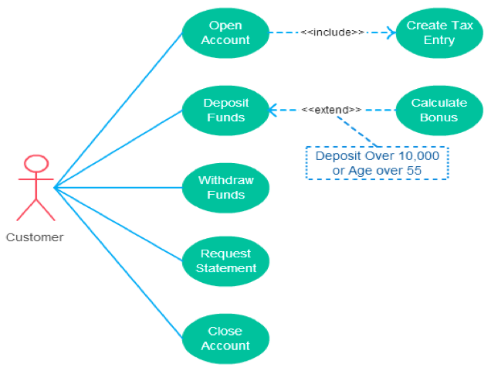
Requirements Elicitation Activities
Use Case

Slide 63
Relationship types in Use Case Diagram
Association between actor and use case
Generalization of an actor
Extend between two use cases
Include between two use cases
Generalization of a use case

Slide 64
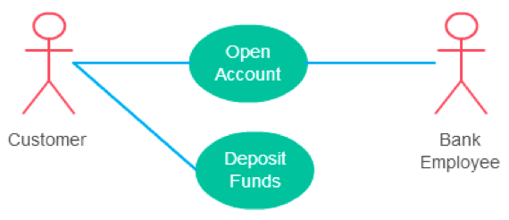
Use Case Diagram
Association between actor and use case
This one is straightforward and present in every use case diagram.
An actor must be associated with at least one use case.
An actor can be associated with multiple use cases.
Multiple actors can be associated with a single use case.

Slide 65
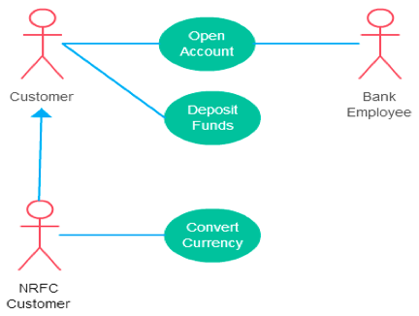
Use Case Diagram
2. Generalization of actor and use case
Generalization of an actor means that one actor can inherit the role of other actor.

Slide 66
Use Case Diagram
3. Extend between two use case
It extends the base use case and adds more functionality to the system.
The extending use case is dependent on the extended (base) use case.
The extending use case is usually optional and can be triggered conditionally.
The extended (base) use case must be meaningful on its own.
Arrow points to the base use case when using <<extend>>
Extending use case is optional

Slide 67
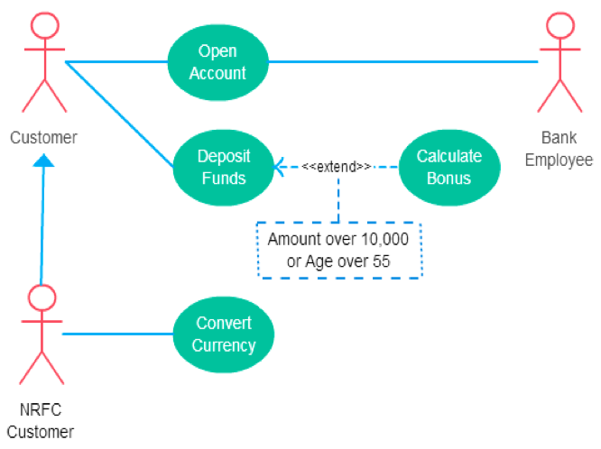
Use Case Diagram
3. Extend between two use case

Slide 68
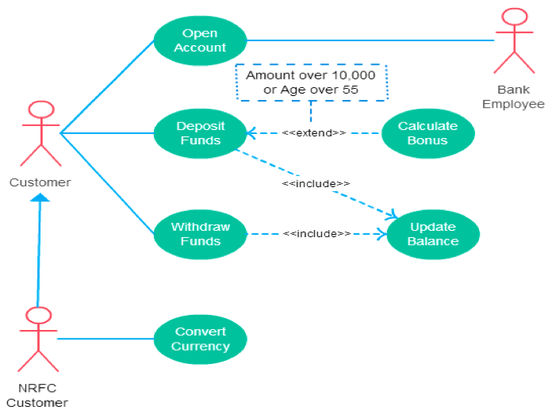
Use Case Diagram
4. Include between two use case
Include relationship show that the behavior of the included use case is part of the including (base) use case.
The base use case is incomplete without the included use case.
The included use case is mandatory and not optional.
Like a “use case subroutine”

Slide 69
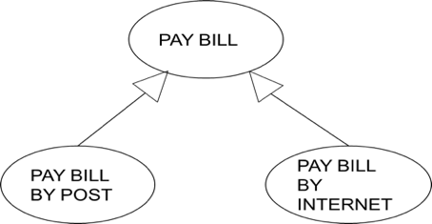
Use Case Diagram
5. Generalisation of a use case
•This is similar to the generalization of an actor.
•This is used when there are common behavior between two use cases and also specialized behavior specific to each use case.

Slide 70
Draw use case diagram.
A vending machine accepts coins for a variety of products. The user selects the drink from products available through the selection panel. If the drink is available the price of the product is displayed. The user the deposits the coins depending on the price of the product. Coin collector collects the coins. After stipulated time, the controller will compare the deposited coins with the price, If the amount deposited is less than the price then error message will be displayed and all deposited coins will be dispensed by coin dispenser else the drink will be dispensed by the product dispenser.

Slide 71
Use Case Diagram for Vending Machine
•Actor- User
•Processes involved in the system
–Select product
–Deposit coins
–Verify the deposited amount
–Dispense product
–Dispense coins

Slide 72
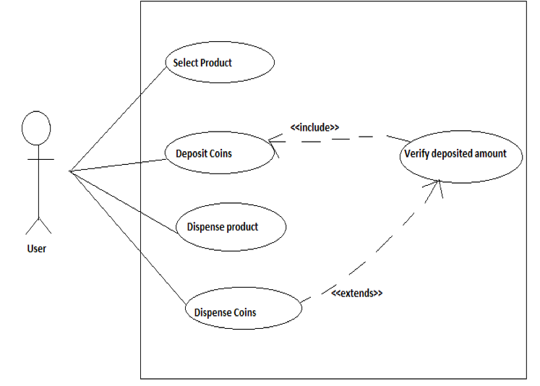
Use Case Diagram for Vending Machine

Slide 73
Use Cases
Template for Use Cases
Use Case name | <variable used to identify the use case>
Participating actors instances | <mention who will be a part of this event>
Flow of event | Step 1 Step 2 ….
Entry Condition
Exit Condition
Quality Requirements

Slide 74
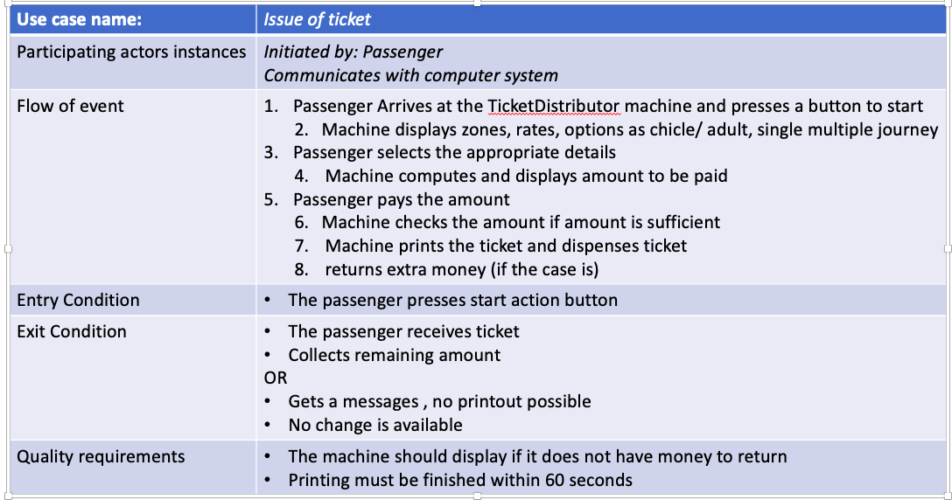
Requirements Elicitation Activities
Sample Use Case: TicketDistributor

Slide 75
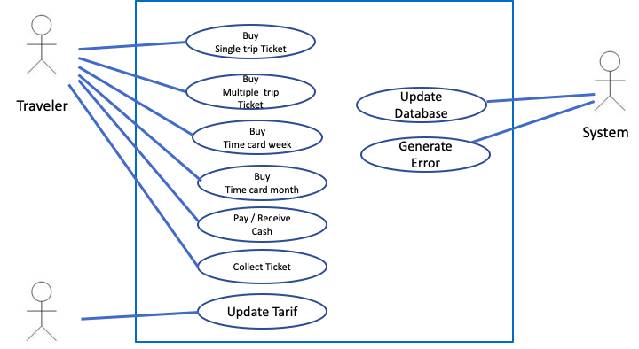
Analysis Model
Use Case Diagram
Maintenance Staff

Slide 76
Requirements Elicitation Activities
•During this Covid-19 pandemic, government was to regulate permission to organize Ganpati Utsav, Navaratri Mandals etc. the authority is interested in setting up a computerised system. It should be an end to end solution providing a facility for various Mandals such as applying for permission rom municipality, electricity board, local police station, firebrigade etc. allocating/ allowing inspection by the officers. Arranging for visarjan of the idols.
•Write down
•Stakeholders
•Functional requirements
•Nonfunctional requirements
•Actors
•Scenarios
•Activities
•Use cases

